Slide 1
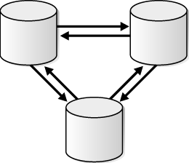





On the Synchronization Bottleneck of
OpenStack-like Object Storage Service
Thierry Titcheu Chekam ^{1,2}, Ennan Zhai ³, Zhenhua Li ¹, Yong Cui ⁴, Kui Ren ⁵
¹ School of Software, TNLIST, and KLISS MoE,
Tsinghua University
² Interdisciplinary Centre for Security, Reliability and Trust,
University of Luxembourg
³ Department of Computer Science, Yale University
⁴ Department of Computer Science and Technology,
Tsinghua University
⁵ Department of Computer Science and Engineering,
SUNY Buffalo
Notes:
As simple Outline of this work, for a certain type of distributed storage system, we FIRST measure the Network traffic and runtime performance of the mechanism that ensure data consistency among servers, SECONDLY we analyze the measured data as well as the documentation and source code of such system under different configuration to find and validate the performance limitation of such mechanism. THIRDLY we propose a new mechanism built on top of the existing one that could provide better performance. FOURTHLY we evaluate our proposed mechanism, comparing its performance to the existing one.

Slide 2
Outline
Background and Motivation
Problem
Proposed Solution
Evaluation
Summary

Slide 3




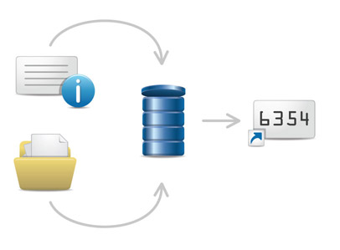












Object Storage Systems
Applications
PUT http://example.com/v1/account/container/new_object
HTTP/REST API
~3,500,000,000 Objects created/day
Storage Cluster
Or Datacenter
Notes:
Define an object(File + metadata). metadata ex: how long should it be stored, creation time, other user defined metadata.
We have storage server that can be anywhere on the Earth that constitute the object storage system.
-When some application need to store data objects.
-they use an API through which the data can be stored. Most common is HTTP/REST, see example.
-Here are some popular Object storage systems.
-The need to be highly scalable and provide high availability. Amazon said in 2013 to have around 3.5 Billion objects created per day.

Slide 4




Availability over Consistency
For better QoS, Some object storage system focus on
High availability at the expense of weaker consistency
Eventual Consistency
Most relax situation
Claim 99.99…
Availability
r Replica nodes
Writes:
At least r/2 +1
replica writes
to succeed
Reads:
Any replica read
Is enough
to succeed
Most Tutorials have r=3 and
experiments are ran with few objects N<1000
All focus on read/Write performance
Notes:
In order to understand the core of Eventual Consistency systems, lets study the case of OpenStack Swift.

Slide 5
Alice
Object Write
Proxy Node
Proxy Node
Proxy Node
OK
Storage Node
Storage Node
Storage Node
Storage Node
OK
...
...
...
...
Storage Node
Storage Node
Storage Node
Storage Node
OK
Zone 1
Zone 2
Zone 3
Zone 4
OpenStack Swift Cluster

Slide 6
Bob
Object Read
Proxy Node
Proxy Node
Proxy Node
Storage Node
Storage Node
Storage Node
Storage Node
...
...
...
...
Storage Node
Storage Node
Storage Node
Storage Node
Zone 1
Zone 2
Zone 3
Zone 4
OpenStack Swift Cluster

Slide 7
Ted
Replicator(Sync)
Hinted Hand-off
Disk Full/Failed
Proxy Node
Proxy Node
Proxy Node
Storage Node
Storage Node
Storage Node
Storage Node
...
...
...
...
Storage Node
Storage Node
Storage Node
Storage Node
Zone 1
Zone 2
Zone 3
Zone 4
OpenStack Swift Cluster

Slide 8







Motivation
How long does it take to sync replica (copies)?
How much is OSync‘s (Object Synchronization) network traffic overhead?
Notes:
In this system for such process (Osync)

Slide 9
Overview
Proposed Solution
  1. Preliminary Measurements
  2. Source Code Analysis & Problem Validation
  4. Comparison between both Mechanisms
  3. Our Proposed Mechanism
Problem
Evaluation

Slide 10
Outline
Background and Motivation
Problem
Proposed Solution
Evaluation
Summary

Slide 11




Measurements Setup
Proxy & Storage
Specifications
28-core Intel Xeon CPUs@2.0 GHz,
32-GB 1600-MHz DDR3
Client &
admin term
8x600-GB 15K-RPM SAS
disk storage,
Two 1-Gbps Broadcom
Ethernet interfaces.
router
1-Gbps
Storage
Storage
During Objects Upload.
During Measurements (Idle: No read/write operation on the system)
More node can be added for larger scale

Slide 12
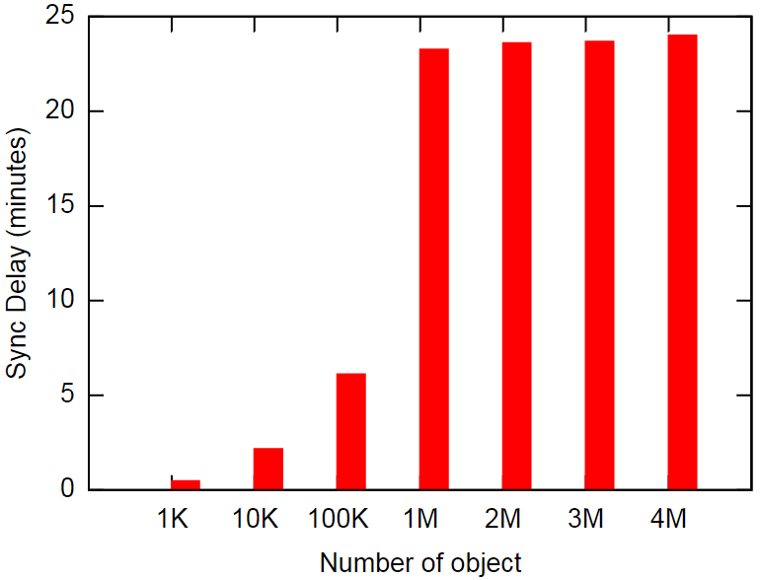
Sync Delay(Check Consistency)
Run repeatedly every 30s
(By Default)
  Runtime increases
  with # objects
x10
+1M

Slide 13
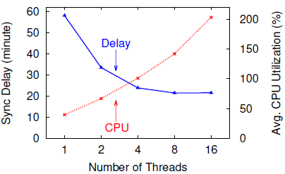

Multithreading
Openstack Swift default Config: object-server.conf
Concurrency=1
  Relation between CPU usage and number of threads
  (r=3, n=5M)

Slide 14
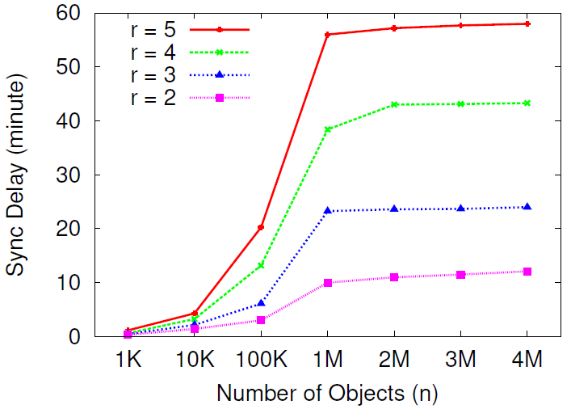
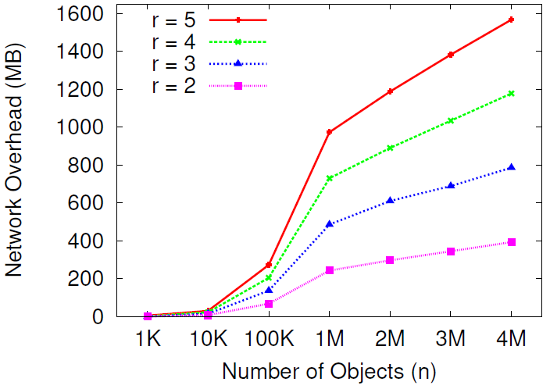
Experimental Results
This experiments have been done on LAN, what about Geo-replication that uses WAN?
Will have much Larger delay
Network Overflow * Total node number = Overall.
~7835 MB (r=5, n=4M)
Notes:
- From the analysis above and the results, we see that the sync delay mainly come from the network.
- The traffic is for each node (synchronization initialized by one node). Each node execute that every 30s.
- Availability is supposed to be higher with larger r.

Slide 15

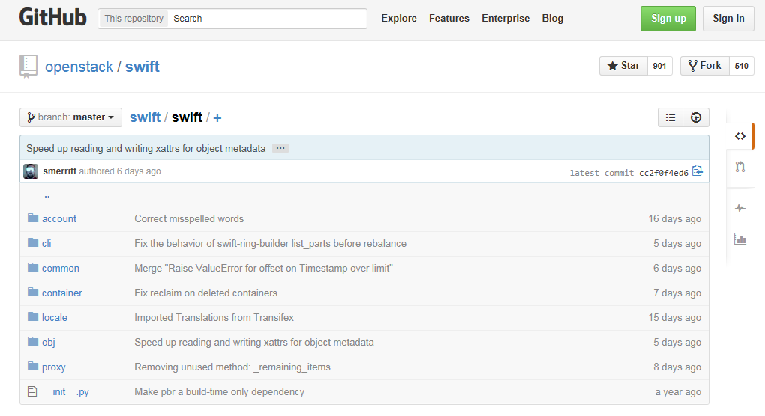
A Step Further
OpenStack Swift is open source
We can use the source code
We found 12 source files to be the most
relevant to our work.
We studied more than ~12800 lines of code
Notes:
Icehouse

Slide 16
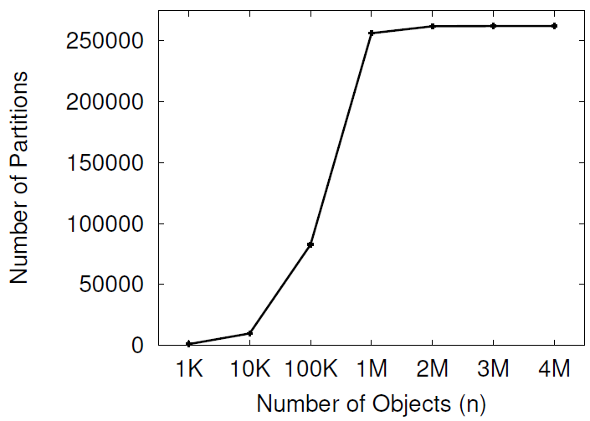
Objects are Stored in Groups
- For load balancing object are stored in N_{p} groups
- The groups are randomly distributed to the nodes
according to the mapping.
Objects Fingerprint data
N_{p} = 2¹⁸
Objects Group
Node
Hashes.pkl
Hashes.pkl
Hashes.pkl
Hashes.pkl
…
Objects
x10
+1M
Notes:
- Depending on the number of nodes on the systems, each node will be assigned a number of groups
Red arrow represent where all groups are generated.
- Group (Partition) is the unit of Synchronisation.

Slide 17
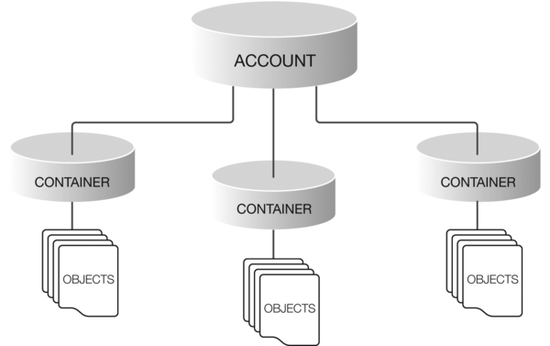
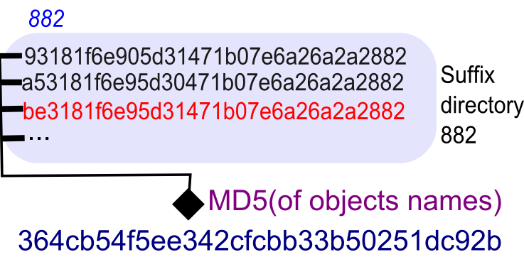
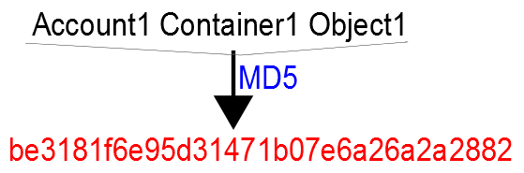
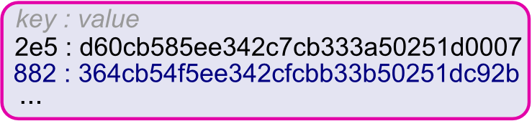
Object Storage Structure
Hashes.pkl size H
Can reach 140 KB
Hashes.pkl

Slide 18
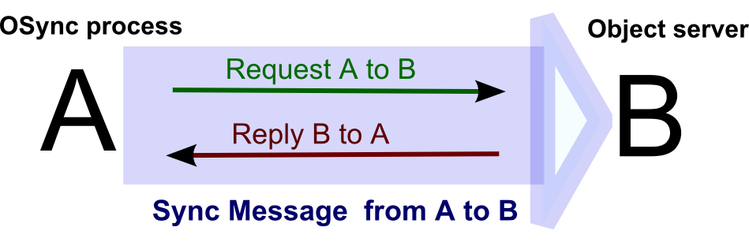
Synchronization Message
The two messages are asynchronous
A
B
Osync process
Object Server
Osync process
Object Server
Notes:
-Let see in detail what a sync message is and how it is delivered
Remove the graph bellow

Slide 19
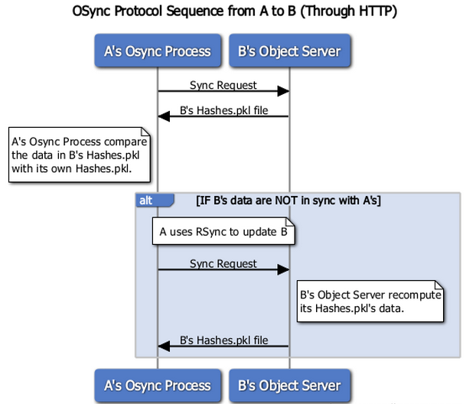
Synchronization Protocol
1
2
3
4
Notes:
-Let see in detail what a sync message is and how it is delivered

Slide 20
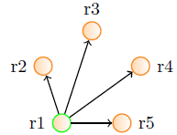
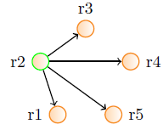
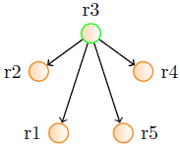
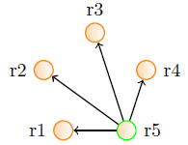
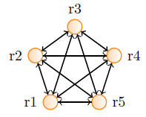
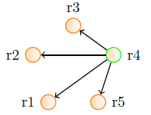
More Findings
r3
r replicas r(r-1) sync messages
r2
r4
r1
r5
r=5, There are 20 messages
Synchronize to:
Ask for hashes.pkl
Compare
…

Slide 21






Systems with Those Issues
Rackspace Cloud Files
4 region
> 75,000,000,000 objects
> 50,000 accounts
(2015 OpenStack Summit)

Slide 22
Outline
Background and Motivation
Problem
Proposed Solution
Evaluation
Summary

Slide 23

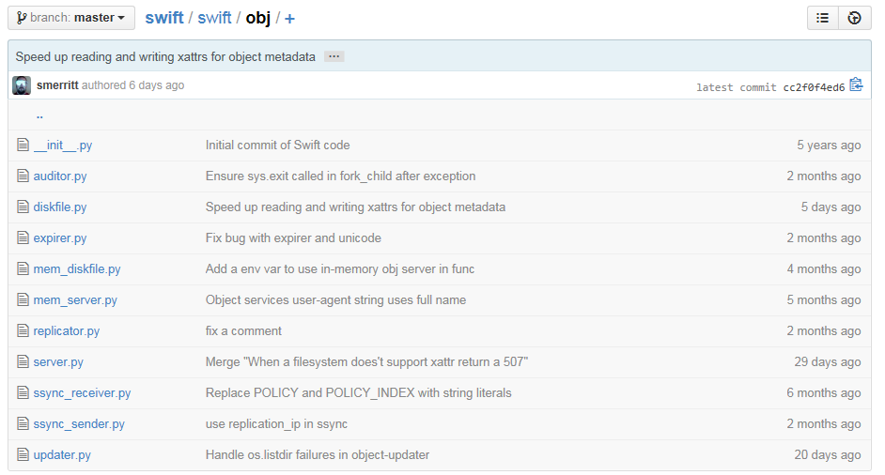
From Existing Mechanism
Openstack Swift is open source
We Can edit the source code
We edited 2 source files.
We added/modified ~200 lines of code.

Slide 24
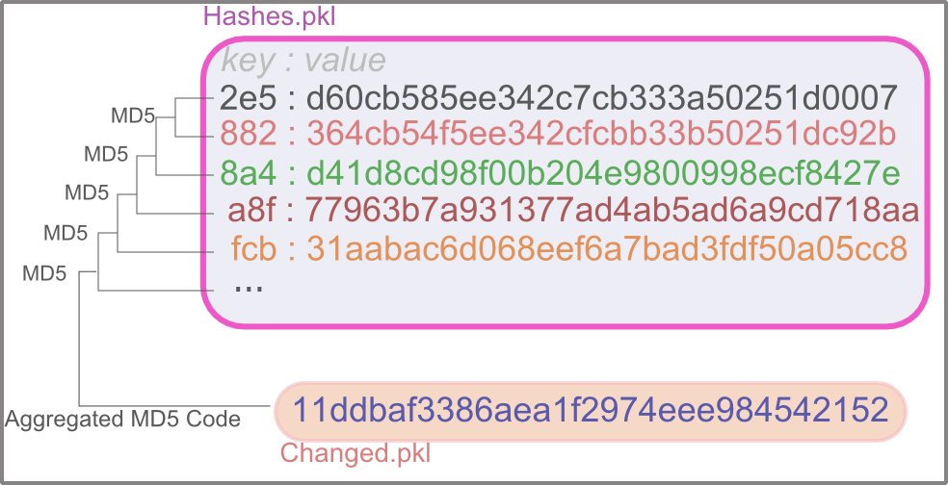
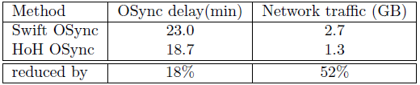
LightSync:Hash of Hashes(HoH)
5 Milion objects
r=3

Slide 25
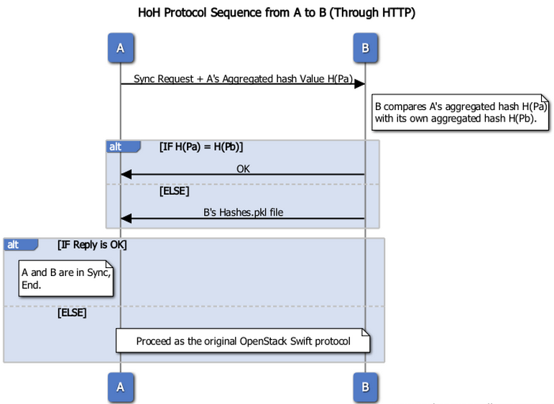
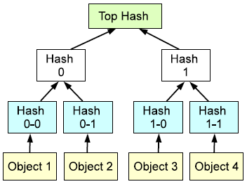
LightSync:HoH’s Protocol
1
2
3
4

Slide 26
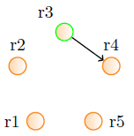
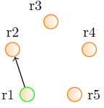
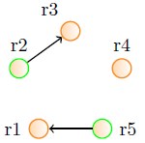
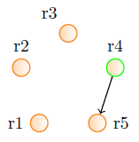
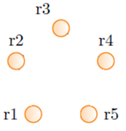
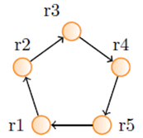


LightSync: Circular Hash Checking(CHC)
Note
We reduce the number of
replication(Sync) messages
From r(r-1) to r
The list of replica is maintained
on each storage node

Slide 27
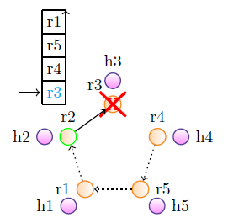
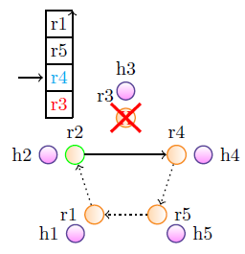
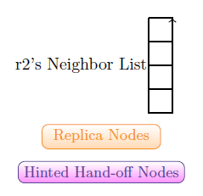
Lightsync: CHC Node Failure

Slide 28
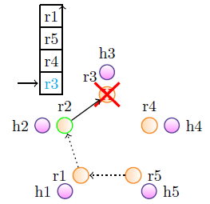
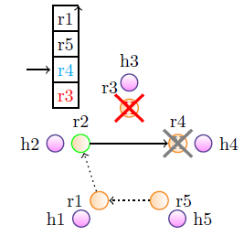
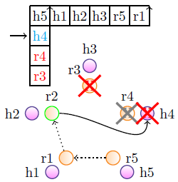
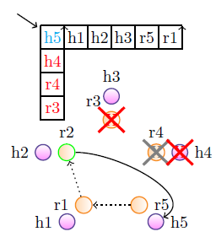
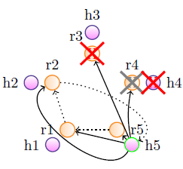
Lightsync: CHC Disk Full/Failed

Slide 29
Outline
Background and Motivation
Problem
Proposed Solution
Evaluation
Summary

Slide 30
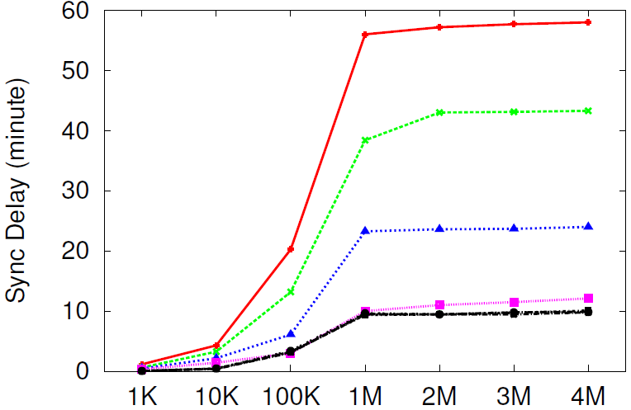
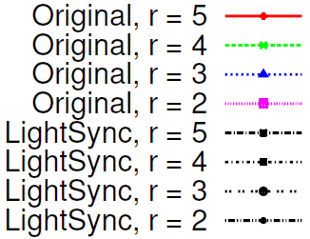
Evaluation: Sync Delay
Replicas already in Sync
(just checking consistency)
~48.23 min
~2.21 min
Notes:
For r=2 only HoH is making the change

Slide 31
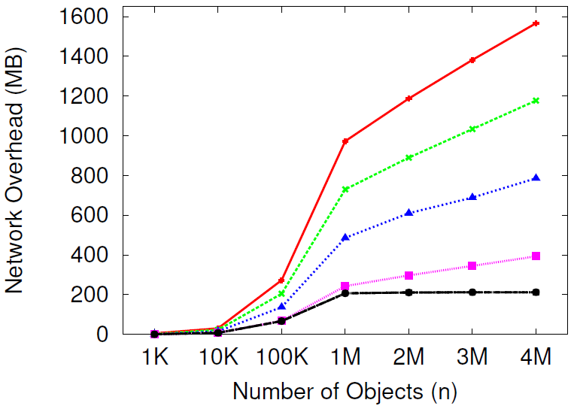
Evaluation: Network Traffic
Network Overflow * Total Node Number = Overall
~7835 MB VS ~1060 MB (r=5, n=4M)
Replicas already in Sync
(just checking consistency)
~1354 MB
~181 MB
N_{p} = 2¹⁸
Notes:
In/Out of each node
For r=2 only HoH is making the change

Slide 32
Outline
Background and Motivation
Problem
Proposed Solution
Evaluation
Summary

Slide 33


Summary
Large number and size of exchanged messages
Large OSync delay
Large Osync network traffic overhead
Improvement: LightSync (HoH + CHC)
LightSync Can also be applied to Containers and Accounts
Notes:
We analyzed the Object synchronization mechanism of a popular type of object storage system and discovered that due to the large number and size of the exchanged messages, the process of checking data consistency experience large delay and network traffic overhead.
We proposed a simple method to reduce such overhead: we use HoH to reduce message size and CHC to reduce the number of exchanged messages.
-Finally we compare our method with the existing mechanism on OpenStack Swift both theoretically and through performance measurements.
-As future work we can use a similar approach for both accounts and container on OpenStack Swift.

Slide 34

Dedication
Titcheu Pierre
(10th April 2016)
Jesus Christ

Slide 35
Thank You!
Questions?

Slide 37

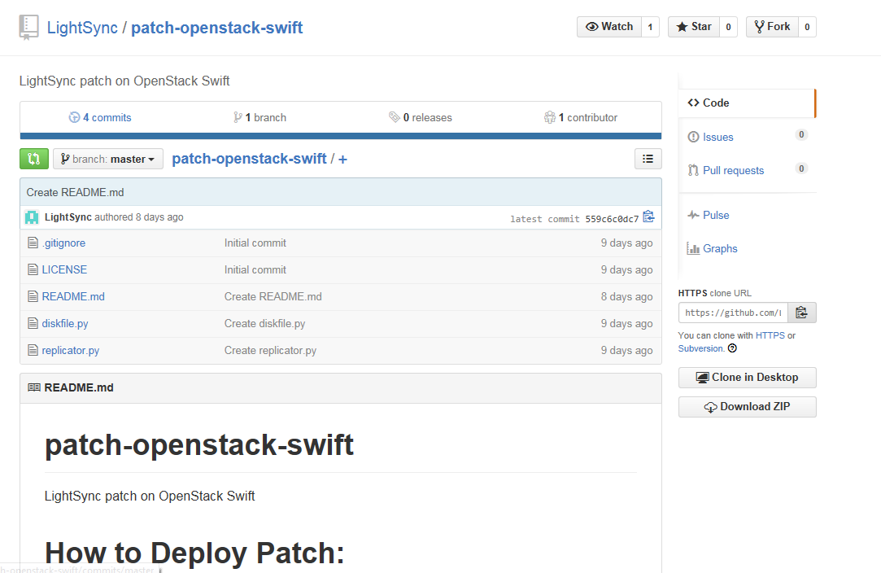
LightSync: Deployed as a Patch
http://github.com/LightSync/patch-openstack-swift

Slide 38

Large Scale Measurements (64 VMs)
Network Overflow * Total Node Number = Overall
r=5, n=4M
Method | OSync Delay(min) | Network Overhead(MB)
Original OpenStack Swift | 76.05 | 849
LightSync | 1.87 | 16.3
Reduced by | 97.5% | 98.08%
Slower Machine
Slower Network
Fewer groups per node (~65 times less)
More hashes per group’s Hashes.pkl file
(~7 times more)
Notes:
In/Out of each node

